Slide 1
Text Classification and Naïve Bayes
The Task of Text Classification

Slide 2
Is this spam?

Slide 3
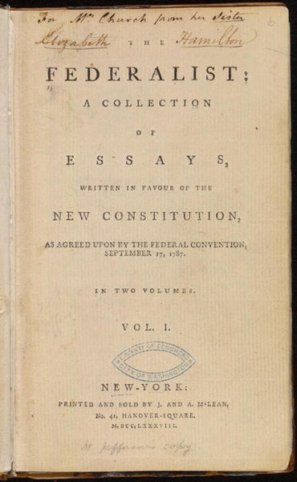
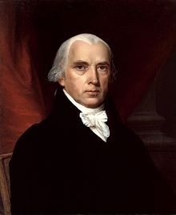
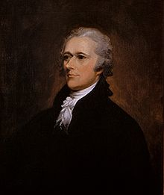
Who wrote which Federalist papers?
1787-8: anonymous essays try to convince New York to ratify U.S Constitution: Jay, Madison, Hamilton.
Authorship of 12 of the letters in dispute
1963: solved by Mosteller and Wallace using Bayesian methods
James Madison
Alexander Hamilton

Slide 4
Male or female author?
By 1925 present-day Vietnam was divided into three parts under French colonial rule. The southern region embracing Saigon and the Mekong delta was the colony of Cochin-China; the central area with its imperial capital at Hue was the protectorate of Annam…
Clara never failed to be astonished by the extraordinary felicity of her own name. She found it hard to trust herself to the mercy of fate, which had managed over the years to convert her greatest shame into one of her greatest assets…
S. Argamon, M. Koppel, J. Fine, A. R. Shimoni, 2003. “Gender, Genre, and Writing Style in Formal Written Texts,” Text, volume 23, number 3, pp. 321–346
Notes:
#1: Saigon. Grey, Anthony
#2: Jerusalem the Golden. Drabble, Margaret
From shlomo argamon

Slide 5


Positive or negative movie review?
unbelievably disappointing
Full of zany characters and richly applied satire, and some great plot twists
this is the greatest screwball comedy ever filmed
It was pathetic. The worst part about it was the boxing scenes.

Slide 6
What is the subject of this article?
MEDLINE Article
MeSH Subject Category Hierarchy
Antogonists and Inhibitors
Blood Supply
Chemistry
Drug Therapy
Embryology
Epidemiology
…
?

Slide 7
Text Classification
Assigning subject categories, topics, or genres
Spam detection
Authorship identification
Age/gender identification
Language Identification
Sentiment analysis
…

Slide 8
Text Classification: definition
Input:
  a document d
  a fixed set of classes C = {c₁, c₂,…, c_{J}}
Output: a predicted class c ∈ C

Slide 9
Classification Methods:
Hand-coded rules
Rules based on combinations of words or other features
  spam: black-list-address OR (“dollars” AND“have been selected”)
Accuracy can be high
  If rules carefully refined by expert
But building and maintaining these rules is expensive

Slide 10
Classification Methods:
Supervised Machine Learning
Input:
  a document d
  a fixed set of classes C = {c₁, c₂,…, c_{J}}
  A training set of m hand-labeled documents (d₁,c₁),....,(d_{m},c_{m})
Output:
  a learned classifier γ:d → c

Slide 11
Classification Methods:
Supervised Machine Learning
Any kind of classifier
  Naïve Bayes
  Logistic regression
  Support-vector machines
  k-Nearest Neighbors
  …

Slide 12
Text Classification and Naïve Bayes
The Task of Text Classification

Slide 13
Text Classification and Naïve Bayes
Naïve Bayes (I)

Slide 14
Naïve Bayes Intuition
Simple (“naïve”) classification method based on Bayes rule
Relies on very simple representation of document
  Bag of words

Slide 15
The bag of words representation
I love this movie! It's sweet, but with satirical humor. The dialogue is great and the adventure scenes are fun… It manages to be whimsical and romantic while laughing at the conventions of the fairy tale genre. I would recommend it to just about anyone. I've seen it several times, and I'm always happy to see it again whenever I have a friend who hasn't seen it yet.
γ(
)=c

Slide 16
The bag of words representation
I love this movie! It's sweet, but with satirical humor. The dialogue is great and the adventure scenes are fun… It manages to be whimsical and romantic while laughing at the conventions of the fairy tale genre. I would recommend it to just about anyone. I've seen it several times, and I'm always happy to see it again whenever I have a friend who hasn't seen it yet.
γ(
)=c

Slide 17
The bag of words representation: using a subset of words
x love xxxxxxxxxxxxxxxx sweet xxxxxxx satirical xxxxxxxxxx xxxxxxxxxxx great xxxxxxx xxxxxxxxxxxxxxxxxxx fun xxxx xxxxxxxxxxxxx whimsical xxxx romantic xxxx laughing xxxxxxxxxxxxxxxxxxxxxxxxxxxxxxxxxxxxxxxxxxxx recommend xxxxx xxxxxxxxxxxxxxxxxxxxxxxxxxxxxxxx several xxxxxxxxxxxxxxxxx xxxxx happy xxxxxxxxx again xxxxxxxxxxxxxxxxxxxxxxxxxxxxxxxxxxxxxxxxxxxxxxx
γ(
)=c

Slide 18
The bag of words representation
great | 2
love | 2
recommend | 1
laugh | 1
happy | 1
... | ...
γ(
)=c

Slide 19
Bag of words for document classification
?
Test
document
Machine Learning
parser
language
label
translation
…
NLP
Garbage
Collection
Planning
GUI
learning
training
algorithm
shrinkage
network...
parser
tag
training
translation
language...
garbage
collection
memory
optimization
region...
planning
temporal
reasoning
plan
language...
...

Slide 20
Text Classification and Naïve Bayes
Naïve Bayes (I)

Slide 21
Text Classification and Naïve Bayes
Formalizing the Naïve Bayes Classifier

Slide 22
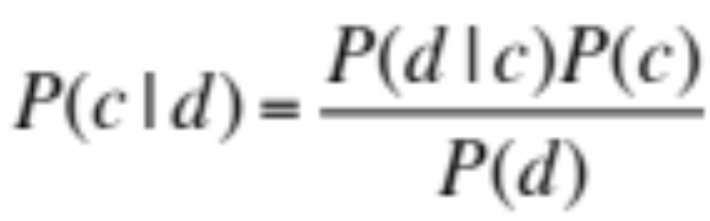
Bayes’ Rule Applied to Documents and Classes
For a document d and a class c

Slide 23
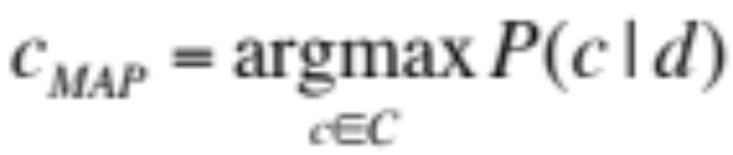
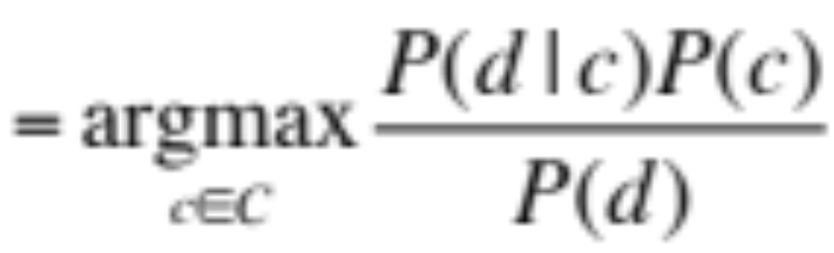
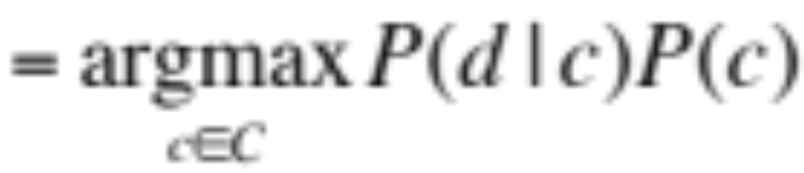
Naïve Bayes Classifier (I)
MAP is “maximum a posteriori” = most likely class
Bayes Rule
Dropping the denominator

Slide 24
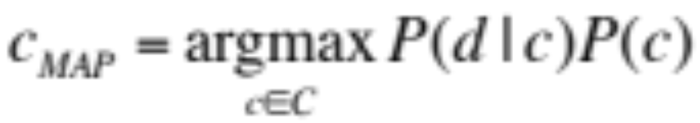
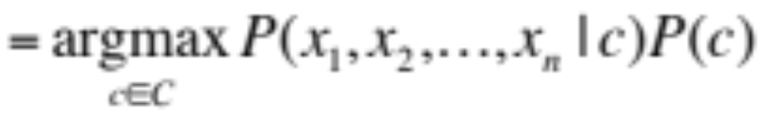
Naïve Bayes Classifier (II)
Document d represented as features x1..xn

Slide 25
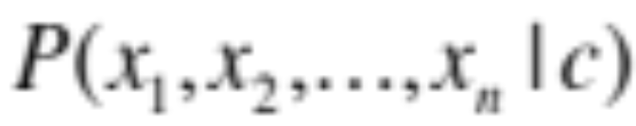
Multinomial Naïve Bayes Independence Assumptions
Bag of Words assumption: Assume position doesn’t matter
Conditional Independence: Assume the feature probabilities P(x_{i}|c_{j}) are independent given the class c.

Slide 26
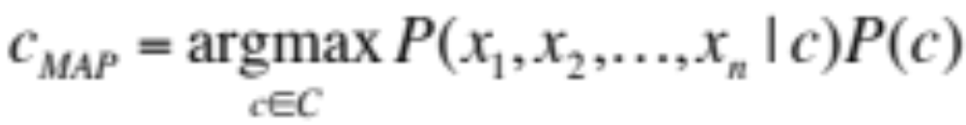
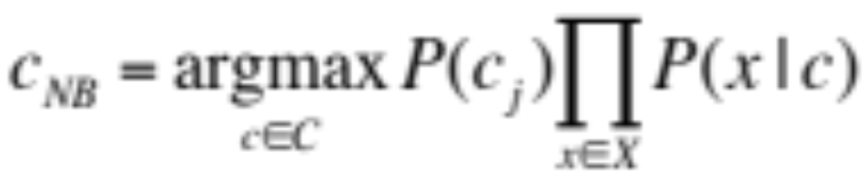
Multinomial Naïve Bayes Classifier

Slide 27
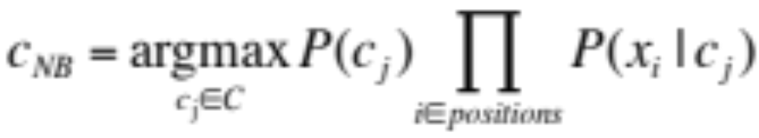
Applying Multinomial Naive Bayes Classifiers to Text Classification
positions ← all word positions in test document

Slide 28
Text Classification and Naïve Bayes
Formalizing the Naïve Bayes Classifier

Slide 29
Text Classification and Naïve Bayes
Naïve Bayes: Learning

Slide 30
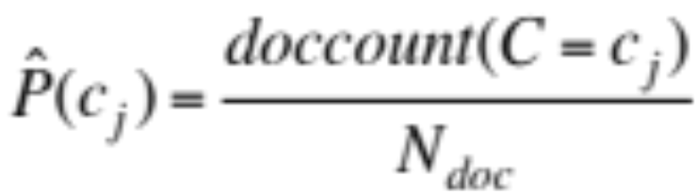
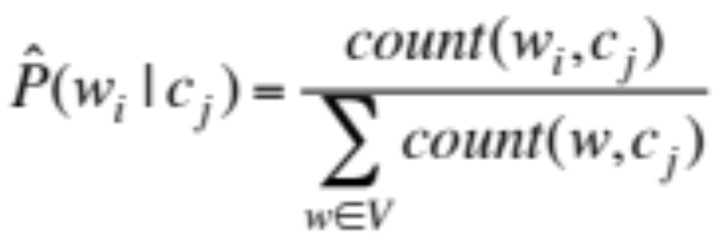
Learning the Multinomial Naïve Bayes Model
Sec.13.3
First attempt: maximum likelihood estimates
  simply use the frequencies in the data

Slide 31
Parameter estimation
fraction of times word w_{i} appears
among all words in documents of topic c_{j}
Create mega-document for topic j by concatenating all docs in this topic
  Use frequency of w in mega-document

Slide 32
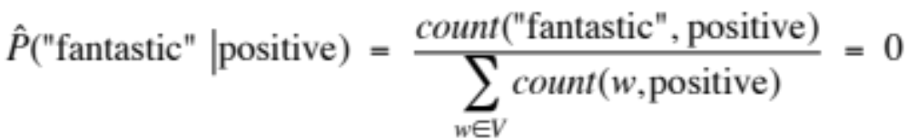
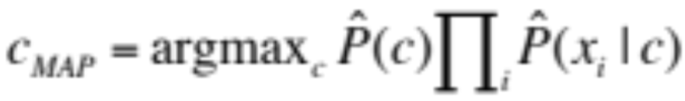
Problem with Maximum Likelihood
Sec.13.3
What if we have seen no training documents with the word fantastic and classified in the topic positive (thumbs-up)?
Zero probabilities cannot be conditioned away, no matter the other evidence!

Slide 33
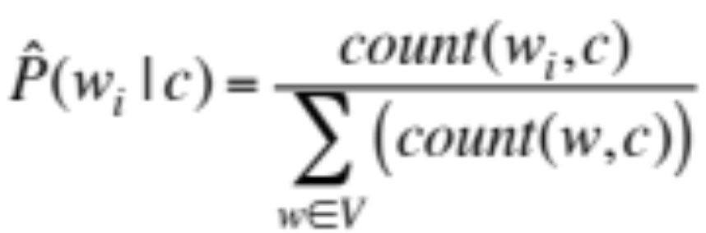
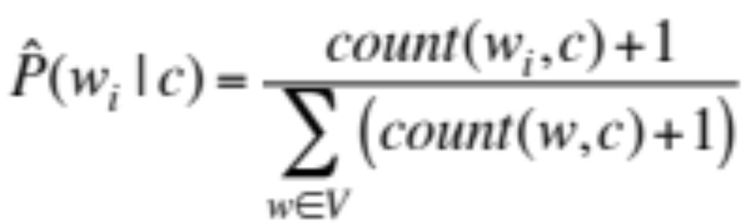
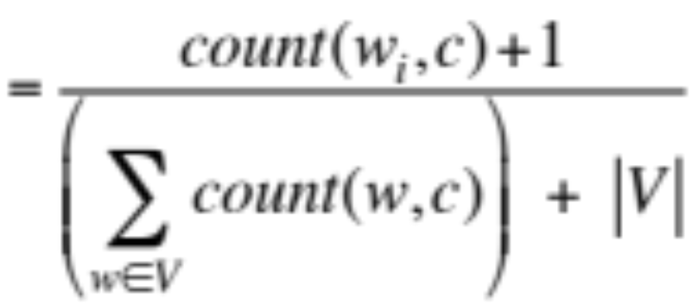
Laplace (add-1) smoothing for Naïve Bayes

Slide 34
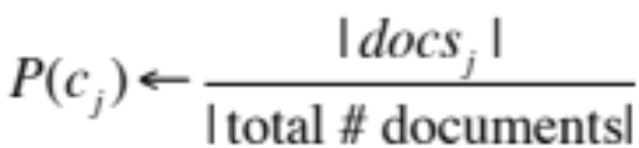
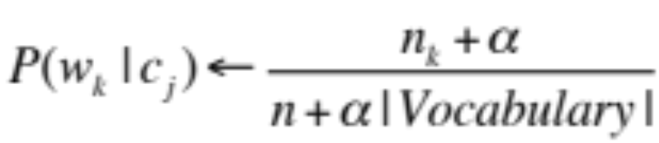
Multinomial Naïve Bayes: Learning
From training corpus, extract Vocabulary
Calculate P(c_{j}) terms
  For each c_{j} in C do
    docs_{j} ← all docs with class =c_{j}
Calculate P(w_{k} | c_{j}) terms
  Text_{j} ← single doc containing all docs_{j}
  For each word w_{k} in Vocabulary
    n_{k} ← # of occurrences of w_{k} in Text_{j}

Slide 35
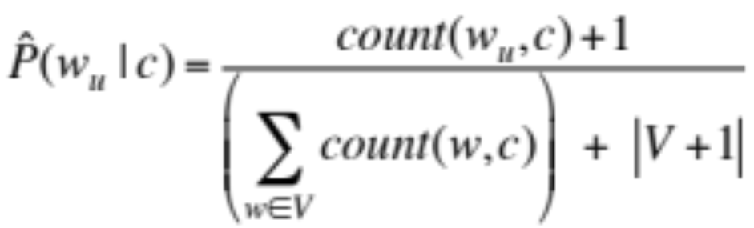
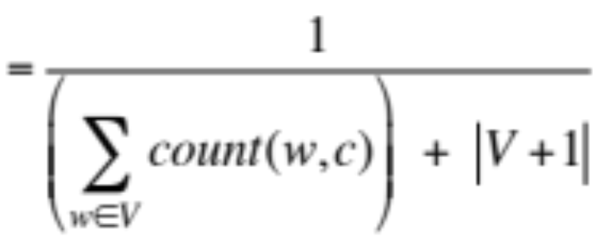
Laplace (add-1) smoothing: unknown words
Add one extra word to the vocabulary, the “unknown word” w_{u}

Slide 36
Text Classification and Naïve Bayes
Naïve Bayes: Learning

Slide 37
Text Classification and Naïve Bayes
Naïve Bayes: Relationship to Language Modeling

Slide 38
Generative Model for Multinomial Naïve Bayes
c=China
X₁=Shanghai
X₂=and
X₃=Shenzhen
X₄=issue
X₅=bonds

Slide 39
Naïve Bayes and Language Modeling
Naïve bayes classifiers can use any sort of feature
  URL, email address, dictionaries, network features
But if, as in the previous slides
  We use only word features
  we use all of the words in the text (not a subset)
Then
  Naïve bayes has an important similarity to language modeling.

Slide 40
Each class = a unigram language model
Sec.13.2.1
Assigning each word: P(word | c)
Assigning each sentence: P(s|c)=Π P(word|c)
Class pos
0.1 I
0.1 love
0.01 this
0.05 fun
0.1 film
…
I
love
this
fun
film
0.1
0.1
.05
0.01
0.1
P(s | pos) = 0.0000005

Slide 41
Naïve Bayes as a Language Model
Sec.13.2.1
Which class assigns the higher probability to s?
Model pos
Model neg
0.2 I
0.001 love
0.01 this
0.005 fun
0.1 film
0.1 I
0.1 love
0.01 this
0.05 fun
0.1 film
I
love
this
fun
film
0.1
0.1
0.01
0.05
0.1
0.2
0.001
0.01
0.005
0.1
P(s|pos) > P(s|neg)

Slide 42
Text Classification and Naïve Bayes
Naïve Bayes: Relationship to Language Modeling

Slide 43
Text Classification and Naïve Bayes
Multinomial Naïve Bayes: A Worked Example

Slide 44
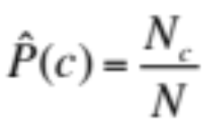
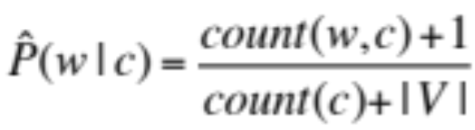
 | Doc | Words | Class
Training | 1 | Chinese Beijing Chinese | c
 | 2 | Chinese Chinese Shanghai | c
 | 3 | Chinese Macao | c
 | 4 | Tokyo Japan Chinese | j
Test | 5 | Chinese Chinese Chinese Tokyo Japan | ?
Priors:
P(c)=
P(j)=
3
4
1
Choosing a class:
P(c|d5)
P(j|d5)
4
  3/4 * (3/7)³ * 1/14 * 1/14
  ≈ 0.0003
Conditional Probabilities:
P(Chinese|c) =
P(Tokyo|c) =
P(Japan|c) =
P(Chinese|j) =
P(Tokyo|j) =
P(Japan|j) =
(5+1) / (8+6) = 6/14 = 3/7
(0+1) / (8+6) = 1/14
  1/4 * (2/9)³ * 2/9 * 2/9
  ≈ 0.0001
(0+1) / (8+6) = 1/14
(1+1) / (3+6) = 2/9
(1+1) / (3+6) = 2/9
(1+1) / (3+6) = 2/9

Slide 45
Summary: Naive Bayes is Not So Naive
Very Fast, low storage requirements
Robust to Irrelevant Features
  Irrelevant Features cancel each other without affecting results
Very good in domains with many equally important features
  Decision Trees suffer from fragmentation in such cases – especially if little data
Optimal if the independence assumptions hold: If assumed independence is correct, then it is the Bayes Optimal Classifier for problem
A good dependable baseline for text classification
  But we will see other classifiers that give better accuracy

Slide 46
Text Classification and Naïve Bayes
Multinomial Naïve Bayes: A Worked Example

Slide 47
Text Classification and Naïve Bayes
Precision, Recall, and the F measure

Slide 48
The 2-by-2 contingency table
 | correct | not correct
selected | tp | fp
not selected | fn | tn
Notes:
precision, recall, f-measure [many have seen before]
there are two sets: CORRECT entities and SELECTED entities
2x2 contingency table, four possible outcomes
for precision & recall, you're ignoring bottom corner (where you get O right)
precision: what proportion of your guesses are correct?
note that correctness means (a) correct boundaries, and (b) correct label
recall: what proportion of true entities did you get right?
ASK STUDENTS HERE ABOUT WHY NOT TO USE ACCURACY
[note that there is typically a trade-off between precision and recall!]
[to get high precision, be very reluctant to make guesses – but then you may have poor recall]
[to get high recall, be very promiscuous in making guesses – but then you may have poor precision]

Slide 49
Precision and recall
Precision: % of selected items that are correct
Recall: % of correct items that are selected
 | correct | not correct
selected | tp | fp
not selected | fn | tn
Notes:
Precision P = tp/(tp + fp)
Recall R = tp/(tp + fn)
Mention precision recall tradeoff.
precision, recall, f-measure [many have seen before]
there are two sets: CORRECT entities and SELECTED entities
2x2 contingency table, four possible outcomes
for precision & recall, you're ignoring bottom corner (where you get O right)
precision: what proportion of your guesses are correct?
note that correctness means (a) correct boundaries, and (b) correct label
recall: what proportion of true entities did you get right?
ASK STUDENTS HERE ABOUT WHY NOT TO USE ACCURACY
[note that there is typically a trade-off between precision and recall!]
[to get high precision, be very reluctant to make guesses – but then you may have poor recall]
[to get high recall, be very promiscuous in making guesses – but then you may have poor precision]

Slide 50
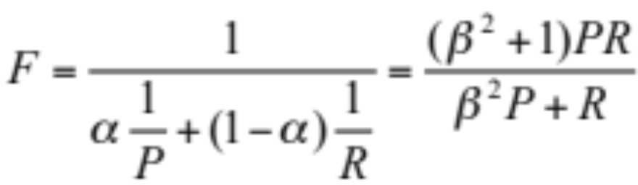
A combined measure: F
A combined measure that assesses the P/R tradeoff is F measure (weighted harmonic mean):
The harmonic mean is a very conservative average; see IIR § 8.3
People usually use balanced F1 measure
  i.e., with β = 1 (that is, α = ½): F = 2PR/(P+R)
Notes:
a combined measure: F-measure: weighted harmonic mean between precision and recall
[why weighted? in some applications you may care more about P or R]
[why harmonic? it's conservative -- lower than arith or geo mean]
[if P and R are far apart, F tends to be near lower value]
[in order to do well on F1, need to do well on BOTH P and R]
[this way, can't beat the system by being either too reluctant or too promiscuous]
Comment: when ppl say f-measure w/o specifying beta, they mean balanced, and this is by far the most common way of doing it

Slide 51
Text Classification and Naïve Bayes
Precision, Recall, and the F measure

Slide 52
Text Classification and Naïve Bayes
Text Classification: Evaluation

Slide 53
More Than Two Classes:
Sets of binary classifiers
Sec.14.5
Dealing with any-of or multivalue classification
  A document can belong to 0, 1, or >1 classes.
For each class c∈C
  Build a classifier γ_{c} to distinguish c from all other classes c’ ∈C
Given test doc d,
  Evaluate it for membership in each class using each γ_{c}
  d belongs to any class for which γ_{c} returns true

Slide 54
More Than Two Classes:
Sets of binary classifiers
Sec.14.5
One-of or multinomial classification
  Classes are mutually exclusive: each document in exactly one class
For each class c∈C
  Build a classifier γ_{c} to distinguish c from all other classes c’ ∈C
Given test doc d,
  Evaluate it for membership in each class using each γ_{c}
  d belongs to the one class with maximum score

Slide 55
Evaluation:
Classic Reuters-21578 Data Set
Sec. 15.2.4
Most (over)used data set, 21,578 docs (each 90 types, 200 toknens)
9603 training, 3299 test articles (ModApte/Lewis split)
118 categories
  An article can be in more than one category
  Learn 118 binary category distinctions
Average document (with at least one category) has 1.24 classes
Only about 10 out of 118 categories are large
Earn (2877, 1087)
Acquisitions (1650, 179)
Money-fx (538, 179)
Grain (433, 149)
Crude (389, 189)
Trade (369,119)
Interest (347, 131)
Ship (197, 89)
Wheat (212, 71)
Corn (182, 56)
Common categories
(#train, #test)

Slide 56
Reuters Text Categorization data set (Reuters-21578) document
Sec. 15.2.4
<REUTERS TOPICS="YES" LEWISSPLIT="TRAIN" CGISPLIT="TRAINING-SET" OLDID="12981" NEWID="798">
<DATE> 2-MAR-1987 16:51:43.42</DATE>
<TOPICS><D>livestock</D><D>hog</D></TOPICS>
<TITLE>AMERICAN PORK CONGRESS KICKS OFF TOMORROW</TITLE>
<DATELINE> CHICAGO, March 2 - </DATELINE><BODY>The American Pork Congress kicks off tomorrow, March 3, in Indianapolis with 160 of the nations pork producers from 44 member states determining industry positions on a number of issues, according to the National Pork Producers Council, NPPC.
Delegates to the three day Congress will be considering 26 resolutions concerning various issues, including the future direction of farm policy and the tax law as it applies to the agriculture sector. The delegates will also debate whether to endorse concepts of a national PRV (pseudorabies virus) control and eradication program, the NPPC said.
A large trade show, in conjunction with the congress, will feature the latest in technology in all areas of the industry, the NPPC added. Reuter
&#3;</BODY></TEXT></REUTERS>

Slide 57
Confusion matrix c
For each pair of classes <c₁,c₂> how many documents from c₁ were incorrectly assigned to c₂?
  c_{3,2}: 90 wheat documents incorrectly assigned to poultry
Docs in test set | Assigned UK | Assigned poultry | Assigned wheat | Assigned coffee | Assigned interest | Assigned trade
True UK | 95 | 1 | 13 | 0 | 1 | 0
True poultry | 0 | 1 | 0 | 0 | 0 | 0
True wheat | 10 | 90 | 0 | 1 | 0 | 0
True coffee | 0 | 0 | 0 | 34 | 3 | 7
True interest | - | 1 | 2 | 13 | 26 | 5
True trade | 0 | 0 | 2 | 14 | 5 | 10

Slide 58
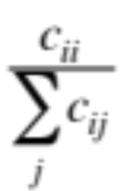
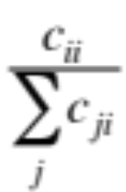
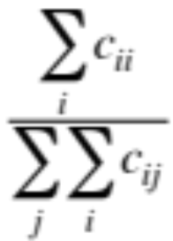
Per class evaluation measures
Sec. 15.2.4
Recall:
Fraction of docs in class i classified correctly:
Precision:
Fraction of docs assigned class i that are actually about class i:
Accuracy: (1 - error rate)
Fraction of docs classified correctly:

Slide 59
Micro- vs. Macro-Averaging
Sec. 15.2.4
  If we have more than one class, how do we combine multiple performance measures into one quantity?
Macroaveraging: Compute performance for each class, then average.
Microaveraging: Collect decisions for all classes, compute contingency table, evaluate.

Slide 60
Micro- vs. Macro-Averaging: Example
Sec. 15.2.4
Class 1
Class 2
Micro Ave. Table
 | Truth: yes | Truth: no
Classifier: yes | 10 | 10
Classifier: no | 10 | 970
 | Truth: yes | Truth: no
Classifier: yes | 90 | 10
Classifier: no | 10 | 890
 | Truth: yes | Truth: no
Classifier: yes | 100 | 20
Classifier: no | 20 | 1860
  Macroaveraged precision: (0.5 + 0.9)/2 = 0.7
  Microaveraged precision: 100/120 = .83
  Microaveraged score is dominated by score on common classes
Notes:
Because f1 ignores true negs and its magnitude is mostly determined by the number of true positives, large classes dominate small classes in microaverage.

Slide 61
Development Test Sets and Cross-validation
Metric: P/R/F1 or Accuracy
Unseen test set
  avoid overfitting (‘tuning to the test set’)
  more conservative estimate of performance
  Cross-validation over multiple splits
    Handle sampling errors from different datasets
  Pool results over each split
  Compute pooled dev set performance
Training set
Development Test Set
Test Set
Training Set
Dev Test
Training Set
Dev Test
Training Set
Dev Test
Test Set

Slide 62
Text Classification and Naïve Bayes
Text Classification: Evaluation

Slide 63
Text Classification and Naïve Bayes
Text Classification: Practical Issues

Slide 64
The Real World
Sec. 15.3.1
Gee, I’m building a text classifier for real, now!
What should I do?

Slide 65
No training data?
Manually written rules
Sec. 15.3.1
If (wheat or grain) and not (whole or bread) then
  Categorize as grain
Need careful crafting
  Human tuning on development data
  Time-consuming: 2 days per class

Slide 66
Very little data?
Sec. 15.3.1
Use Naïve Bayes
  Naïve Bayes is a “high-bias” algorithm (Ng and Jordan 2002 NIPS)
Get more labeled data
  Find clever ways to get humans to label data for you
Try semi-supervised training methods:
  Bootstrapping, EM over unlabeled documents, …

Slide 67
A reasonable amount of data?
Sec. 15.3.1
Perfect for all the clever classifiers
  SVM
  Regularized Logistic Regression
You can even use user-interpretable decision trees
  Users like to hack
  Management likes quick fixes

Slide 68
A huge amount of data?
Sec. 15.3.1
Can achieve high accuracy!
At a cost:
  SVMs (train time) or kNN (test time) can be too slow
  Regularized logistic regression can be somewhat better
So Naïve Bayes can come back into its own again!

Slide 69
Accuracy as a function of data size
Sec. 15.3.1
With enough data
  Classifier may not matter
Brill and Banko on spelling correction

Slide 70
Real-world systems generally combine:
    Automatic classification
    Manual review of uncertain/difficult/"new” cases

Slide 71
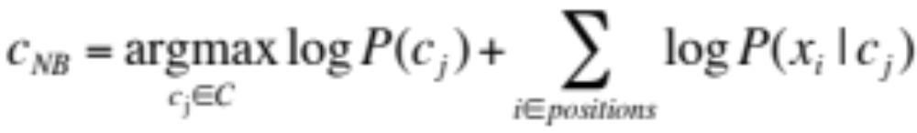
Underflow Prevention: log space
Multiplying lots of probabilities can result in floating-point underflow.
Since log(xy) = log(x) + log(y)
  Better to sum logs of probabilities instead of multiplying probabilities.
Class with highest un-normalized log probability score is still most probable.
Model is now just max of sum of weights

Slide 72
How to tweak performance
Sec. 15.3.2
    Domain-specific features and weights: very important in real performance
    Sometimes need to collapse terms:
  Part numbers, chemical formulas, …
  But stemming generally doesn’t help
Upweighting: Counting a word as if it occurred twice:
  title words (Cohen & Singer 1996)
  first sentence of each paragraph (Murata, 1999)
  In sentences that contain title words (Ko et al, 2002)

Slide 73
Text Classification and Naïve Bayes
Text Classification: Practical Issues

